Slide 1

Interactive 3D Experience
Lesson 7:
Scalable UI
Elyas Chua-Aziz
cel9@np.edu.sg
Diploma in IM
October 2021

Slide 2
Designing Scalable UI
When creating an AR application, it is important to note that it may be deployed on multiple different platforms.
E.g. mobile phones, tablets, laptops, headsets, etc.
This makes it necessary for developers to create UI that can scale according to the different screen sizes of these devices.
To help us achieve scalable UI, we will use Anchors in the UI system of Unity.

Slide 3
Learning Objectives
Utilize Anchors and Scaling Canvas to create UI that can adapt to different screen sizes.

Slide 4
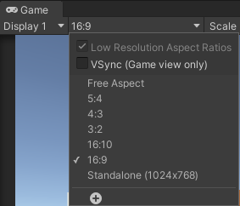
Rect Transforms
Rect Transforms work differently to the usual Transforms we have been working with.
Transforms are used to determine how far and what rotation an object is from the world origin (0, 0, 0)
Rect Transforms are not concerned about the world origin, and instead need to know how it’s aligned in relation to its anchor point.
Before working on UI, set your target aspect ratio in the Game view. This will make sure you are designing your UI to the correct dimensions.

Slide 5

Anchors
Anchors will determine where your UI element will maintain its offset position from.
E.g. an image with an anchor in the middle of a canvas will maintain its position in the middle even if the canvas moves/scales.
Anchors are shown as four small triangular handles in the Scene View.
“together” anchor.
This anchor means our object will move along with its anchor.
“split” anchor.
This anchor means our object will move and scale with its anchor.

Slide 6
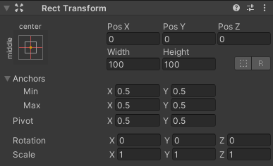
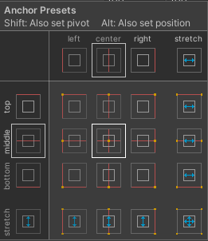
Anchors
We can set where our anchor points are either through pressing the Anchor Preset Button or editing the X and Y values of the anchors.
When choosing an Anchor Preset, the yellow dot(s) depicts what type of anchor is used, and where the anchor point is.
For presets with 1 yellow dot, a “together” anchor is used.
For presets with 2 or more dots, a “split” anchor is used.

Slide 7
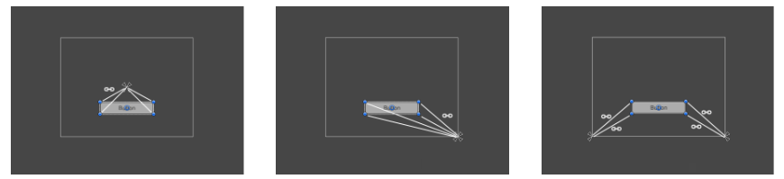
Anchors
UI element anchored to the center of its parent.
UI element anchored to the bottom right of its parent.
UI element with its right and left corners anchored to the bottom right and left of its parent respectively.

Slide 8
Anchors
The positions of the anchors are defined in fractions (or percentages) of the parent rectangle width and height.
0.0 (0%) corresponds to the left or bottom side.
0.5 (50%) to the middle.
1.0 (100%) to the right or top side.
However, anchors can be placed at any point within the parent Rect Transform and are not limited to the sides and middle.

Slide 9
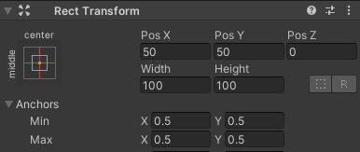
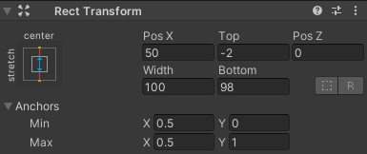
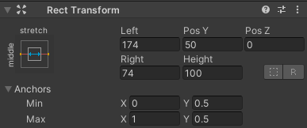
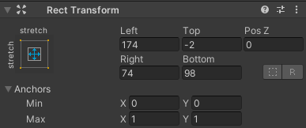
Using Anchors
When using a “together” anchor, the fields displayed are ‘Pos X’, ‘Pos Y’, ‘Width’, and ‘Height’.
The Pos X and Y values indicate the position of the object relative to its anchor.
When using a “split” anchor, the fields displayed can change partially or completely to Left, Right, Top and Bottom.
These fields define the padding inside the parent Rect Transform defined by the anchors.

Slide 10
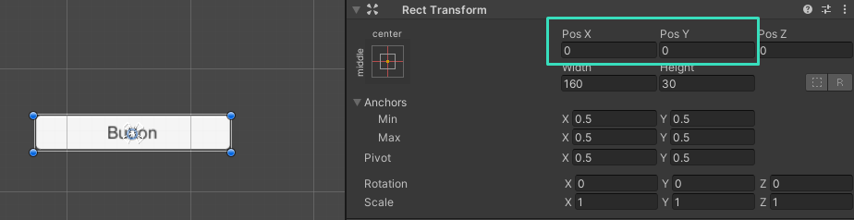
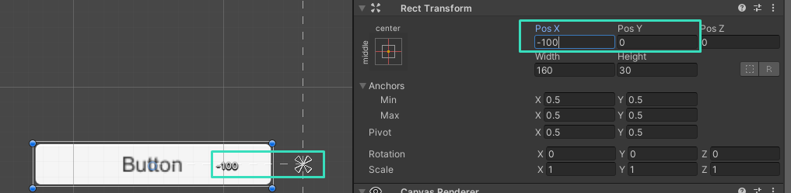
Using Anchors
When using a “together” anchor, the x and y position values in the RectTransform tells the UI object how far away from its anchor it should be.
This UI Button will be 0 units from it’s anchor, so it will be directly on top of the anchor
This UI Button will be -100 horizontal units from its anchor, so it will be on the left.

Slide 11
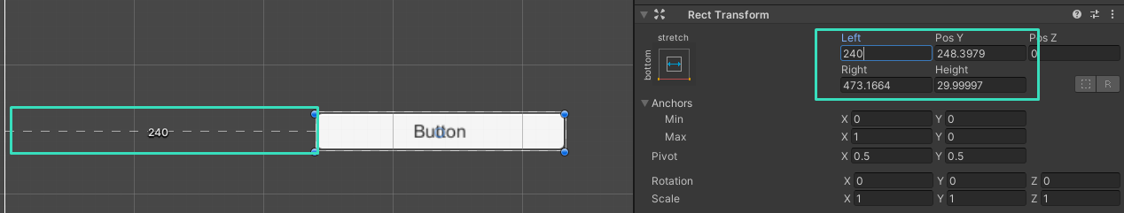
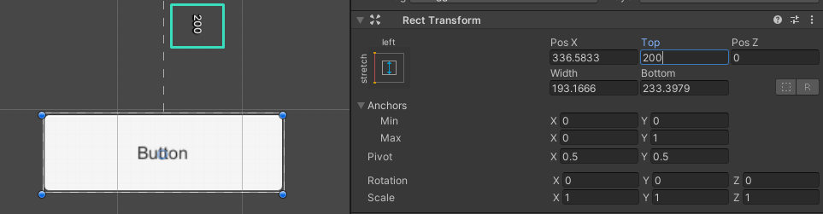
Using Anchors
When using a “split” anchor, the position values in the RectTransform tells the UI object how far away from each SIDE should be from the anchor.
These values will remind constant even as the Canvas changes size, which is what makes our UI objects scale.
The left side of this UI Button will always be 240 units away from the left split anchor.
The top side of this UI Button will always be 200 units away from the top split anchor.

Slide 12
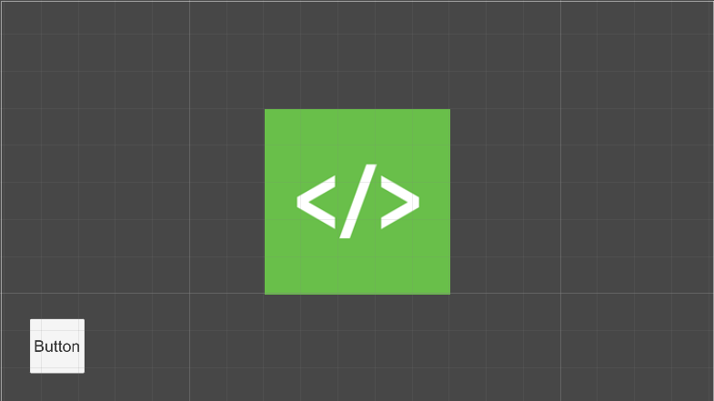
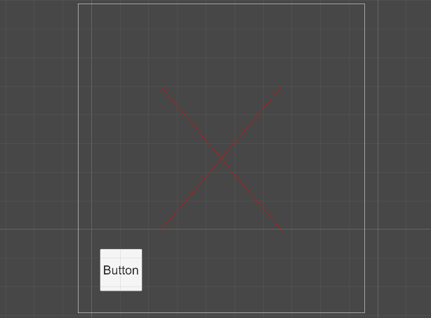
Using Anchors
However, because the values don’t change when using a split anchor, this also means that when the canvas becomes a smaller size, our image will disappear.
The canvas on the left has an image in the middle with a split anchor. When the size of the canvas becomes too small, the image will disappear.

Slide 13
Using Anchors
To avoid this, it is always better to design your UI for a smaller screen first.
So set your Canvas to be a bit smaller than you need it to be.
Then, using a combination of split and together anchors, have your separate UI objects scale and position themselves accordingly for different screen sizes.
Utilize anchors in your project for Assignment 1 to make sure that your UI works for different screen sizes and orientation.

Slide 14
Summary
Developing an AR application results in developers having to cater to various screen sizes and orientations.
Unity helps developers with the Anchors feature so that one UI design can appear similar, if not the same, across these various screens.
Developers can use either:
“Together” anchors to have UI only reposition themselves as screen size changes.
OR
“Split” anchors to have UI reposition and scale themselves as screen size changes.

